Slide 1
Atlantic Masters
3-Feb-2021
Swimmer’s Corner

Slide 2
Technique Tidbits
By adjusting our technique, we hope to swim:
Further
Efficiently
Faster
Our own swimming style should:
Take advantage of our own flexibility
Allow us to meet our goals
Not cause non-muscular discomfort
Notes:
Efficiency:
Our goal when swimming is to develop forward propulsion to drive our body through the water while minimizing the amount of drag that is created by our body.
Waste:
Any activity that doesn’t provide forward propulsion or increases the natural drag of our body is working against achieving this goal.

Slide 3
Warning!!!
These are just a few techniques that have been shown to help swimmers in general. Apply them based on your own abilities.
Changing your stroke can be equivalent to learning to swim for the first time!
Consider your goals and where you are in your training journey before you begin.
Notes:
If you want to try to change your stroke, consider doing it in small ways.
By changing your technique, you are going to be using muscles differently and may require you to build strength.

Slide 4
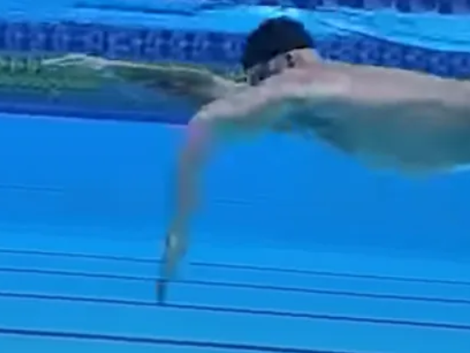
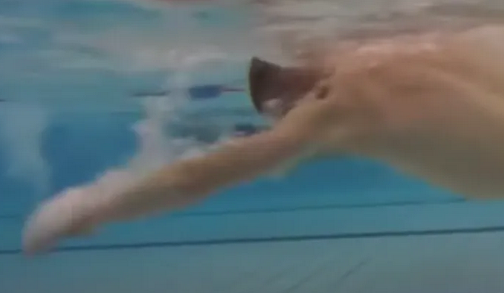
Technique Tidbits Early Vertical Forearm (EVF) – The cure for a dropping elbow
Forward propulsion is provided by directing water with the palm of your hand towards your feet.
Position your forearm vertically as early as possible in your stroke to maximize the distance you can push water in the appropriate direction.
Can you spot the difference?
This is the ultimate cure to dropping your elbows!
Notes:
Smooth 100: https://www.youtube.com/watch?v=wvVZZy-8fv4

Slide 5
Technique Tidbits A Full Stroke – No Early Exit
Be sure to push water beyond the hips.
Notes:
Demonstrate by standing

Slide 6
Technique Tidbits Breathing – When and How
As hand passes shoulders, face back in water
Turn head as little as possible (Some use the trick of keeping one eye in the water.)
Be sure not to stress your jaw

Slide 7
Technique Tidbits Feet Sinking? It’s all in the head
You can’t always swim the same way in every environment, so know how to adjust your balance.
Wetsuit impact and floating feet?
Some wetsuits are made to offer more buoyancy for legs due to their audience. If your feet don’t sink in the pool, look for wetsuits that are not unusually thick on the legs
Raise the head through the chin
Slight core engagement
Salt water impact
Float higher in the water
Impacts breathing position

Slide 8
Some Good Videos
Common Mistakes: https://www.youtube.com/watch?v=s2h0tFWwqFc
A smooth 100: https://www.youtube.com/watch?v=wvVZZy-8fv4

